Slide 1


做好开源客服系统
行动号召：给春松客服 Star
github.com/chatopera/cskefu
分享内容在 5 秒后开始

Slide 2

春松客服大讲堂
2019 © 北京华夏春松科技有限公司

Slide 3

春松客服大讲堂
做好开源客服系统
春松客服开发环境
王海良
主讲老师/华夏春松联合创始人&CEO
Chatopera 用户群
春松客服，Chatopera 机器人平台用户讨论群
2019 © 北京华夏春松科技有限公司

Slide 4

自我介绍
王海良，Chatopera联合创始人&CEO，微软人工智能
最有价值专家。2011年毕业于北邮，后加入IBM工作四
年，先后工作于软件开发实验室和创新中心。从2016年
开始工作于创业公司，三角兽AI算法工程师，呤呤英语
AI产品负责人，负责智能对话系统研发，2018年出版
《智能问答与深度学习》一书。

Slide 5
分享大纲
春松客服大讲堂
5.3 春松客服开发入门
项目管理之Maven
开发环境之IntelliJ IDEA
代码导读

Slide 6
项目管理之Maven
春松客服大讲堂
5.3 春松客服开发入门

Slide 7
问题分析
春松客服大讲堂
5.3 春松客服开发入门
我们在开发Java应用时，面对哪些问题？
源代码版本声明
执行单元测试
库文件依赖管理
打包
文件目录结构标准化
部署
项目脚手架
API文档
集成开发环境无缝衔接
发布项目

Slide 8
解决方案
春松客服大讲堂
5.3 春松客服开发入门
plugins
dependencies
……
Local Repository
pom.xml
deploy
install
项目描述
Remote Repository
mvn 命令
Nexus Server
项目管理工具

Slide 9
解决方案
春松客服大讲堂
Maven Lifecycles
5.3 春松客服开发入门
Notes:
https://i.stack.imgur.com/DU5hL.png
https://stackoverflow.com/questions/26607834/maven-lifecycle-vs-phase-vs-plugin-vs-goal
Lifecycles, Lifecycle Phases, Plugins and Plugin Goals are the core of Maven.
The Maven command mvn can accept only Lifecycle Phase or Plugin Goal as argument.
Maven comes with three lifecycles – default, clean and site.
Each lifecycle is made up of lifecycle phases and in all, there are 28 phases – default 21(validate, ..., compile, ..., package, ..., install, deploy), clean 3(pre-clean, clean, post-clean) and site 4(pre-site, site, post-site, site-deploy).
when a lifecycle phase is invoked using mvn command
Lifecycles as yellow rectangles
Phases of lifecycles as blue rectangles with "callable" phases in darker blue (i.e. the phases with hypenation are not usually called from the command line as they may not be designed to leave the project in a well-defined state).
Goals as blue lozenges. The association/binding "phase -> goal" shown is the one of the "jar" packaging mode. Every phase can have goals bound to it. This holds of course for each of the lifecycles, although bindings are only show for the "default" lifecycle.
Plugins as grey clipped rectangles. Plugins provide the Goals that can be bound to the Phases.

Slide 10
解决方案
春松客服大讲堂
5.3 春松客服开发入门
Cleaning
Building
Testing
Packaging
Installing
Phases
clean
compile
resources
test
jar
Goals
install
Notes:
https://stackoverflow.com/questions/26607834/maven-lifecycle-vs-phase-vs-plugin-vs-goal
Lifecycles, Lifecycle Phases, Plugins and Plugin Goals are the core of Maven.
The Maven command mvn can accept only Lifecycle Phase or Plugin Goal as argument.
Maven comes with three lifecycles – default, clean and site.
Each lifecycle is made up of lifecycle phases and in all, there are 28 phases – default 21(validate, ..., compile, ..., package, ..., install, deploy), clean 3(pre-clean, clean, post-clean) and site 4(pre-site, site, post-site, site-deploy).
when a lifecycle phase is invoked using mvn command, all preceding phases are executed sequentially one after another.
lifecycle phases by themselves doesn’t have any capabilities to accomplish some task and they rely on plugins to carryout the task.
depending on project and packaging type, Maven binds various plugin goals to lifecycle phases and goals carryout the task entrusted to them.
When we run "mvn package" in a Java Project, Maven binds plugin goals to lifecycle phases as shown in the next figure.

Slide 11
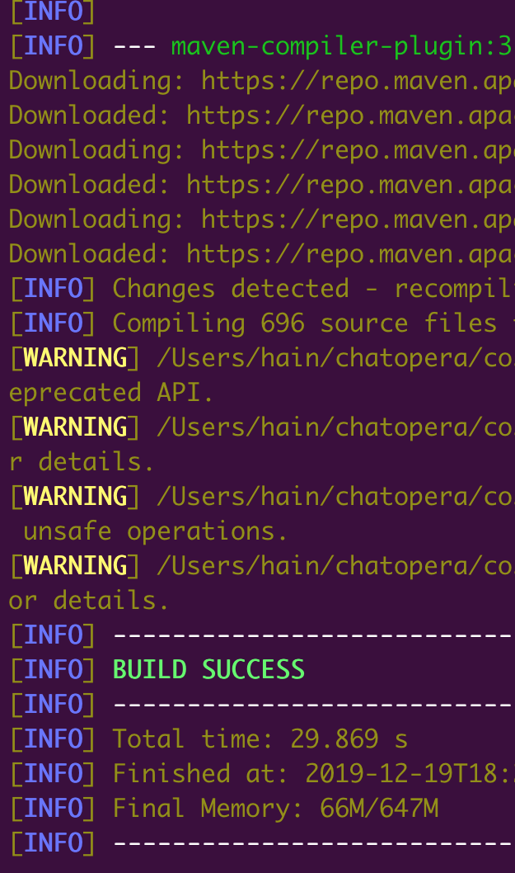
解决方案
春松客服大讲堂
5.3 春松客服开发入门
mvn [options] [goal(s)] [phase(s)]
mvn compile
pom.xml
<build>
<plugins>
<plugin> <artifactId>maven-compiler-plugin</artifactId> <configuration> <source>1.8</source> <target>1.8</target> <encoding>UTF-8</encoding>
Notes:
https://stackoverflow.com/questions/26607834/maven-lifecycle-vs-phase-vs-plugin-vs-goal
Lifecycles, Lifecycle Phases, Plugins and Plugin Goals are the core of Maven.
The Maven command mvn can accept only Lifecycle Phase or Plugin Goal as argument.
Maven comes with three lifecycles – default, clean and site.
Each lifecycle is made up of lifecycle phases and in all, there are 28 phases – default 21(validate, ..., compile, ..., package, ..., install, deploy), clean 3(pre-clean, clean, post-clean) and site 4(pre-site, site, post-site, site-deploy).
when a lifecycle phase is invoked using mvn command, all preceding phases are executed sequentially one after another.
lifecycle phases by themselves doesn’t have any capabilities to accomplish some task and they rely on plugins to carryout the task.
depending on project and packaging type, Maven binds various plugin goals to lifecycle phases and goals carryout the task entrusted to them.
When we run "mvn package" in a Java Project, Maven binds plugin goals to lifecycle phases as shown in the next figure.

Slide 12
打包Artifact
春松客服大讲堂
5.3 春松客服开发入门
<groupId>com.chatopera.cc</groupId> <artifactId>contact-center</artifactId> <version>5.0.0</version> <packaging>war</packaging> <name>cskefu</name> <description>春松客服：多渠道智能客服系统</description> <parent> <groupId>org.springframework.boot</groupId> <artifactId>spring-boot-starter-parent</artifactId> <version>1.5.10.RELEASE</version> <relativePath/> </parent>
Maven世界里组合文件的形式，作为版本管理的单元。
jar, war, pom, rar, maven-plugin, etc都可以用Artifact管理。

Slide 13
Artifact版本定义
春松客服大讲堂
1.4 客服的日常工作
<major version>.<minor version>.<incremental version>-<qualifier>
<version>5.0.0-SNAPSHOT</version>
Notes:
我们可以频繁的发布SNAPSHOT版本，以便让其它项目能实时的使用到最新的功能做联调；当版本趋于稳定时，再发布一个正式版本，供正式使用。当然在做正式发布时，也要确保当前项目的依赖项中不包含对任何SNAPSHOT版本的依赖，保证正式版本的稳定性。https://books.sonatype.com/mvnref-book/reference/pom-relationships-sect-pom-syntax.html

Slide 14
脚手架工程
春松客服大讲堂
5.3 春松客服开发入门
mvn archetype:generate \
-DgroupId=com.chatopera.sample \
-DartifactId=sample \
-DarchetypeArtifactId=maven-archetype-simple \
-DarchetypeVersion=1.3 \
-DinteractiveMode=false \
-DarchetypeCatalog=internal
Notes:
演示脚手架工程，
#1
Mvn compile
Mvn clean
Mvn idea:idea 导入IDEA
#2
Mvn test
mvn dependency:tree
Mvn site:site, open sample/target/site/index.html
Mvn Javadoc:Javadoc, open sample/target/site/apidocs/index.html
#3
mvn -Dtest=AppTest#testApp test
Mvn package
Mvn install # 在本地 .m2查看

Slide 15
春松客服POM文件解读
春松客服大讲堂
1.4 客服的日常工作
contact-center/app/pom.xml

Slide 16
组织内发布项目
春松客服大讲堂
1.4 客服的日常工作
文件发布到哪里？

Slide 17
Sonatype Nexus OSS
春松客服大讲堂
1.4 客服的日常工作
The free artifact repository with universal format support.
Store and distribute Maven/Java, npm, NuGet, RubyGems, Docker, P2, OBR, APT and YUM and more.
Manage components from dev through delivery: binaries, containers, assemblies, and finished goods.
Awesome support for the Java Virtual Machine (JVM) ecosystem, including Gradle, Ant, Maven, and Ivy.

Slide 18
私有的包管理服务
春松客服大讲堂
1.4 客服的日常工作
snapshot
Private Nexus Service
settings
开发测试机
release
proxy
settings
cache
生产环境
Central - Maven Repository

Slide 19
Chatopera Nexus Service
春松客服大讲堂
1.4 客服的日常工作
发布春松客服依赖的项目文件：jar, pom等
https://nexus.chatopera.com/

Slide 20
开发环境之IntelliJ IDEA
春松客服大讲堂
5.3 春松客服开发入门

Slide 21
搭建春松客服开发环境
春松客服大讲堂
5.3 春松客服开发入门
数据库
Liveload 文件
安装IDEA
断点调试
配置
快捷方式
DEBUG模式启动项目

Slide 22
代码导读
春松客服大讲堂
5.3 春松客服开发入门

Slide 23
代码结构
春松客服大讲堂
3.2 春松客服的运维管理
Templates
Controller
Proxy
Model
Database

Slide 24


做好开源客服系统
Chatopera 公众号
Chatopera 用户群
最新更新，动态
春松客服，Chatopera 机器人平台用户讨论群
2019 © 北京华夏春松科技有限公司

Slide 25
资源
文档中心: https://docs.chatopera.com
开源地址: http://github.com/chatopera
春松客服: https://github.com/chatopera/cskefu
博客地址: https://blog.chatopera.com
Chatopera云服务: https://bot.chatopera.com/
2019 © 北京华夏春松科技有限公司

